Slide 1
Text Analysis in R
2023-04-25
Christian Overgaard
CME, Journalism Vertical
Big thanks to Jo Lukito!!

Slide 2
Workshop Goals
Provide you with the skills needed to do basic text analysis.
How to look for messages containing a word? (e.g., 🇺🇦🇺🇦)
How to find the most common words in a dataset?
... and how to visualize top words/frequencies?
This beginner workshop is meant for both qualitative and quantitative researchers. We will not go into depth about advanced NLP models.

Slide 3
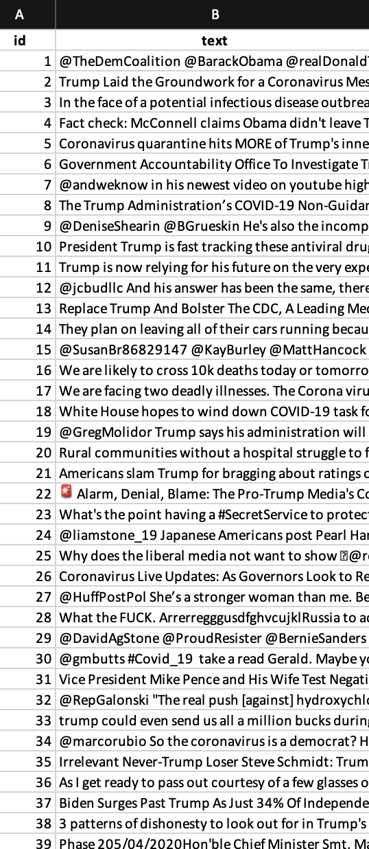
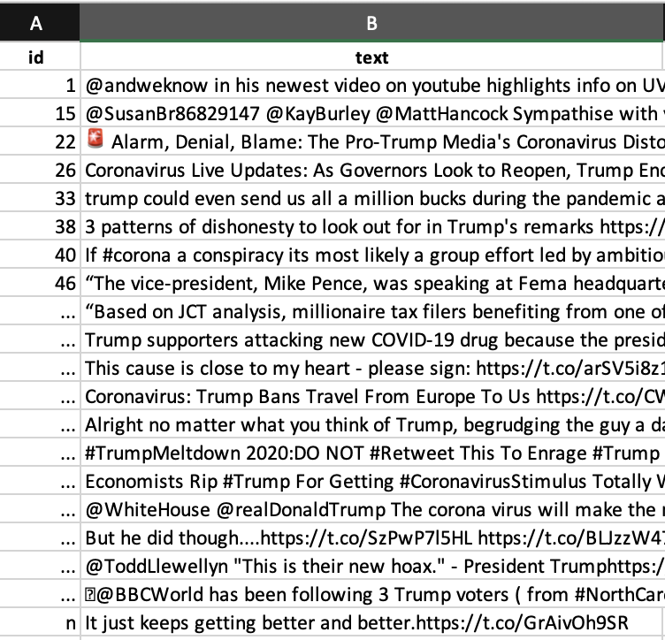

Examples of what you’ll learn today
Extract just the messages that
where written by a specific account, or
that mention a specific word or set of words

Slide 4
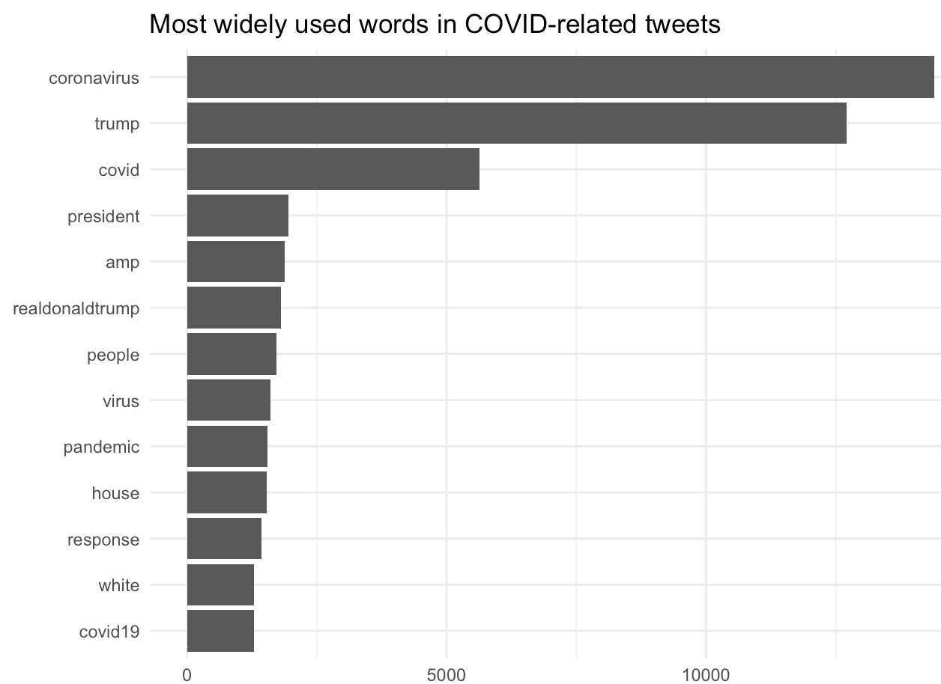
Examples of what you’ll learn today
Bar chart

Slide 5
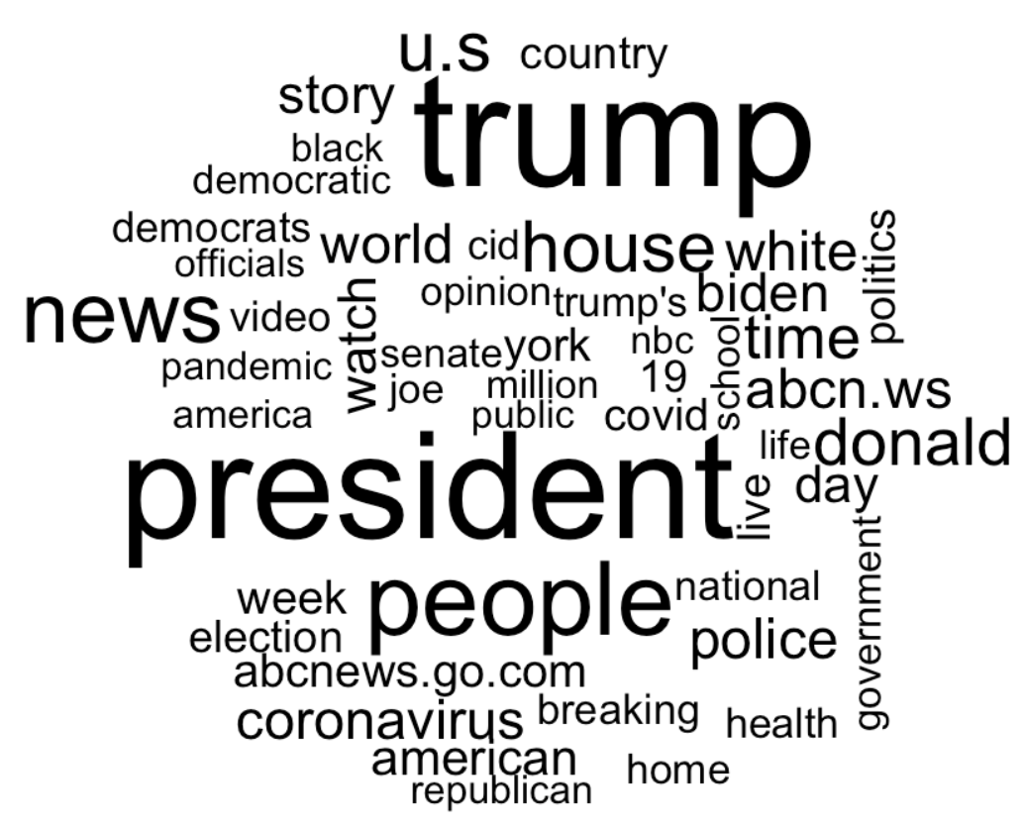
Examples of what you’ll learn today
Word cloud

Slide 6
“Subfields” Analyzing Text
Natural Language Processing (computer science)
Computational Linguistics (linguistics)
Text as Data (political science, political communication)
Computer-assisted content analysis (communication)
Natural language: language generated by humans. Text: written natural language.

Slide 7
How computers “read” text
Computers are very dumb and cannot read text.
But they can read when two characters are different (“a” != “A”). And they can tell how many characters are in a string.
A character: a unit of information equivalent to one alphabetic letter or symbol. A string: a bunch of characters.

Slide 8
Characters and Strings
How many characters are in this string? (Don’t count the quotation marks)
“apple”
Notes:
5

Slide 9
Characters and Strings
How many characters are in this string? (Don’t count the quotation marks)
“apples”

Slide 10
Characters and Strings
How many characters are in this string? (Don’t count the quotation marks)
“Apples suck.”
Note: “Apple” is a substring in “Apples suck.”

Slide 11
Characters, Strings, and Patterns
Computers can’t understand text, but they can recognize patterns.
This is where regular expressions come in!
“a sequence of symbols and characters expressing a string or pattern to be searched for within a longer piece of text.”

Slide 12
Using Regular Expressions to look for things
“Funny video! http://t.co/12345” “Important article by @Person: http://t.co/abcde” “http://t.co/lov2write” “Why are people like this #sodumb http://t.co/BadArticle”
We can use regular expressions to identify the urls:
“http://t.co/.{5,11}$”
Two resources:
https://regex101.com/
Cheatsheet: https://paulvanderlaken.files.wordpress.com/2017/08/r-regular-expression-cheetsheat.pdf

Slide 13
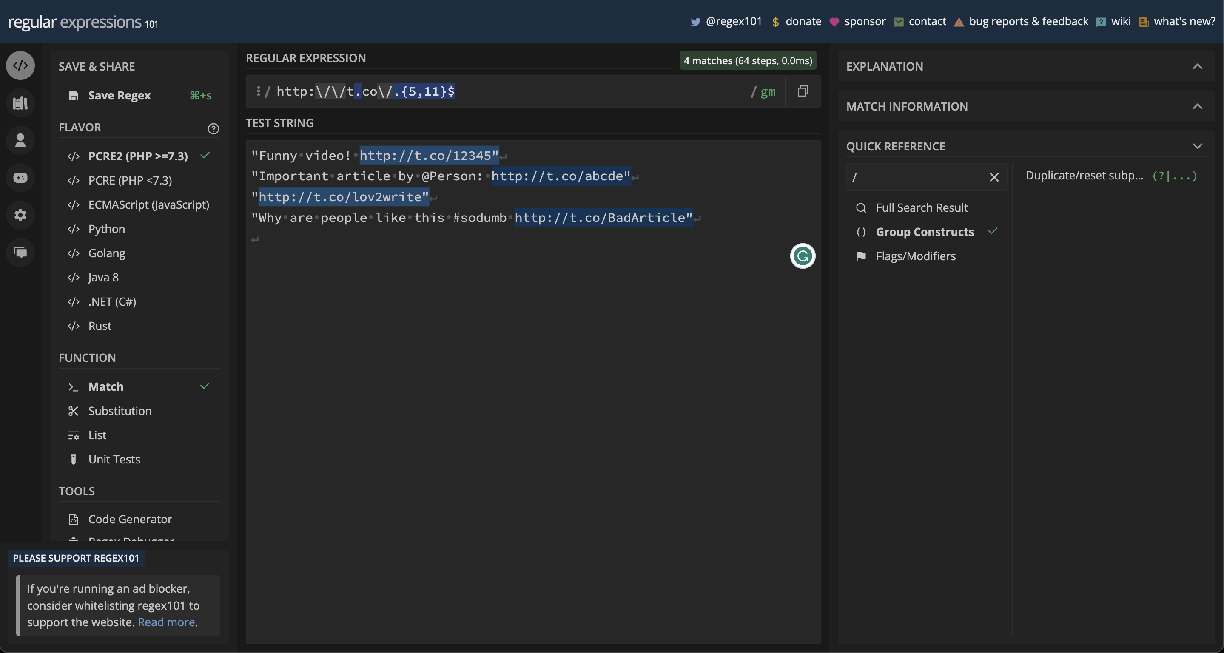
https://regex101.com/

Slide 14
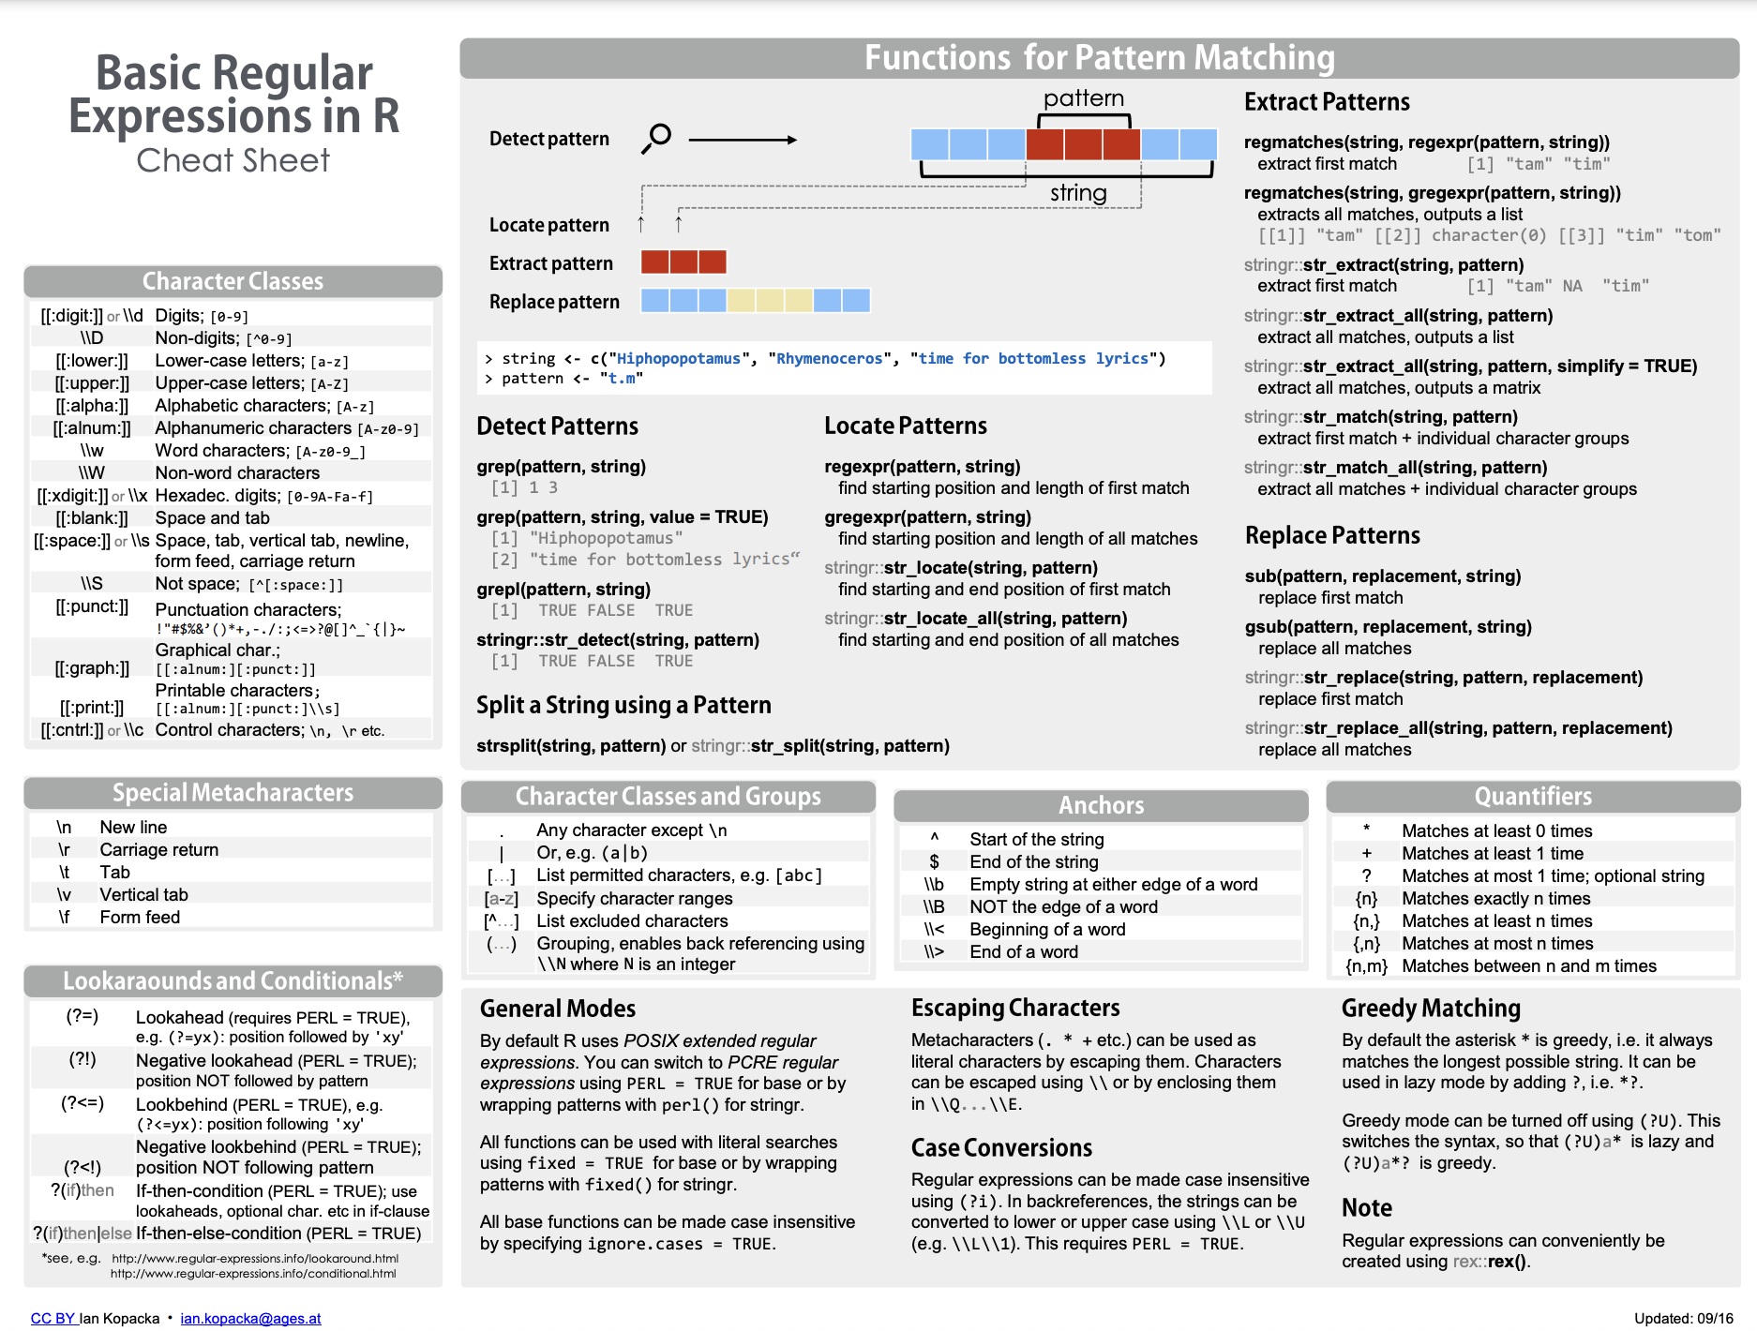

Slide 15
Beyond Regular Expressions: Tokenizing
Searching for messages containing a word may be useful, but sometimes, you want some aggregate descriptives, too.
How do we go about processing data so our (stupid) computer can understand what we mean?

Slide 16
Tokenizing (v.)
“to break (text) into individual linguistic units.” (Source: Oxford Languages)
We often tokenize sentences into individual words (called “tokens”). But you can also tokenize an article into its sentences, or a sentence into “n-grams”

Slide 17
Tokenizing (v.)
“to break (text) into individual linguistic units.” (Source: Oxford Languages)
We often tokenize sentences into individual words (called “tokens”). But you can also tokenize an article into its sentences, or a sentence into “n-grams”
“Apples suck.”

Slide 18
Tokenizing (v.)
“to break (text) into individual linguistic units.” (Source: Oxford Languages)
We often tokenize sentences into individual words (called “tokens”). But you can also tokenize an article into its sentences, or a sentence into “n-grams”
“Apples suck.”
“Bananas are so so much better”

Slide 19
Tokenized Structure
When you tokenize a sentence, or message into word-tokens, each “word” is treated as its own thing:
One string: “Bananas are so so much better”
Tokenized: c(“Bananas”, “are”, “so”, “so”, “much”, “better”)

Slide 20
N-grams
Unigram: One word (e.g., "banana")
Bigram: Two words (e.g., "good banana")
Trigram: Three words (e.g., "very good banana")
N-gram: N words
“Bananas are so much better”

Slide 21
R Workshop
I encourage you to follow along on your own computer (but it’s not required). To do so:
Open this file: TextAnalysisWorkshopApril2023.Rproj
Open this file: 01-Text Analysis in R - Activity 1.Rmd
Check that you have the required R packages

